Slide 1

SMART PARKING

Slide 2
Introduction IOT smart parking
Integrating camera-based solutions for image processing to detect parking spaceavailability is a practical and effectiveapproach. Here are some key considerationsand steps for implementing such a systemCamera selection:It is important to select right cameras forimage processing to detect space availability

Slide 3
For camera selection we can use thesecameras:Fixed Cameras: These are stationary camerasthat provide a fixed view of the parking area.They are suitable for monitoring specific zonesor entrance/exit areas.Pan-Tilt-Zoom (PTZ) Cameras: PTZ camerascan be remotely controlled to pan, tilt, andzoom, allowing for flexible coverage andtracking of moving objects within the parkinglot

Slide 4
360-Degree Cameras: These camerasprovide a wide field of view, capturing acomplete view of the surroundings withoutthe need for multiple fixed cameras

Slide 5
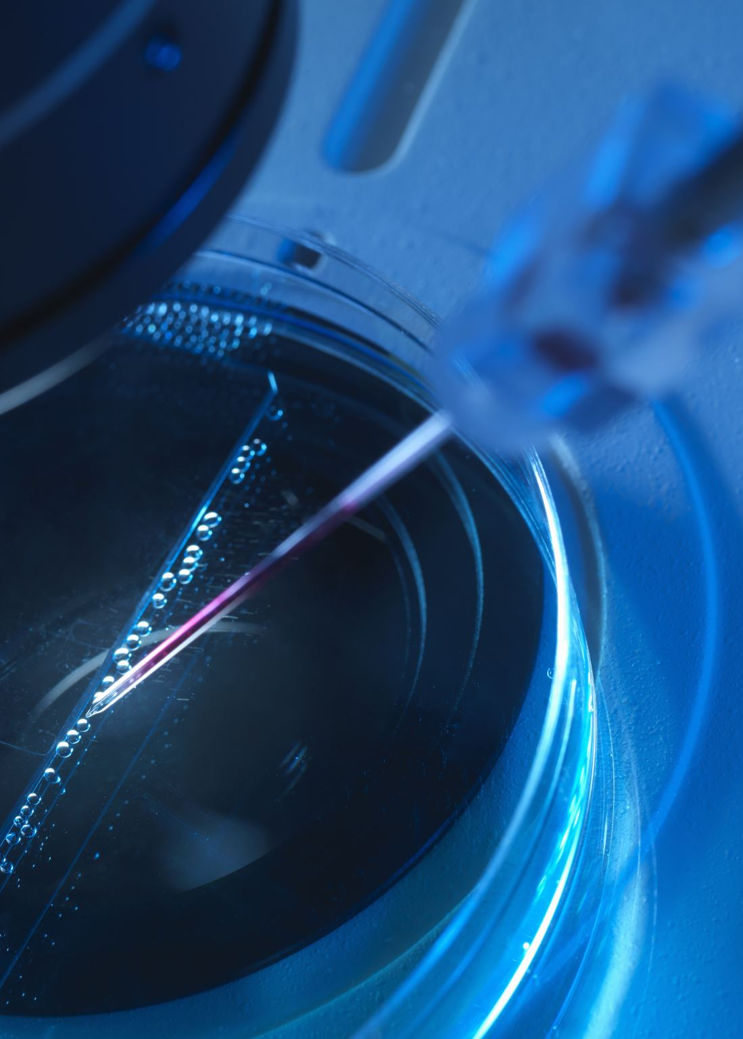
IOT Sensor
Sensors and important in smart parkingbecause it is used to detect space availabilityIn here we can use IOT sensors such asultrasonic sensor, infrared Sensor andmagnetic sensor

Slide 6
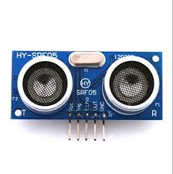
Ultrasonic Sensor
Ultrasonic IoT sensors, often referred to asultrasonic distance sensors or ultrasonicranging sensors, are a type of sensorthatuses sound waves to measure the distancebetween the sensor and an object orsurface. These sensors are commonly usedin various IoT applications, including smartparking systems. Here’s how they work andsome of their key characteristics

Slide 7
Emission of Ultrasonic Waves: The sensor emits high-frequency ultrasonic waves (sound waves) in the ultrasonic range, typically beyond the range of human hearing
Distance Calculation: Using the speed of sound in the air (which is approximately 343 meters per second or 1,125 feet per second at room temperature), the sensor calculates the distance to the object based on the time it took for the sound waves to travel to the object and back

Slide 8
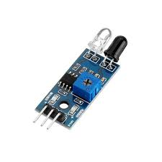
Infrared Sensor
Infrared sensors, often referred to as IR sensors, are devices that can detect and measure the presence, proximity, motion, or temperature of objects and people by emitting and receiving infrared radiation. These sensors are used in various applications, from home automation to industrial automation and security systems. Here are some key aspects of infrared sensors.

Slide 9
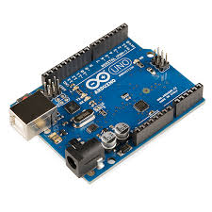
Arduino uno
The Arduino Uno is built around the Atmega328P microcontroller, which is part of the AVR family of microcontrollers.
The Arduino Uno is a popular microcontroller board that is widely used for prototyping and DIY electronics projects. Here are some key features and information about the Arduino Uno.

Slide 10
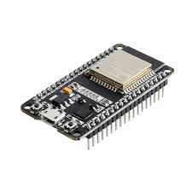
ESP32
The ESP32 is a powerful and versatile microcontroller unit (MCU) that is commonly used in a wide range of electronic projects and IoT (Internet of Things) applications. Here are some key features and information about the ESP32.
The ESP32 features a dual-core Tensilica Xtensa LX6 processor, which allows for more complex and parallel processing tasks.

Slide 11
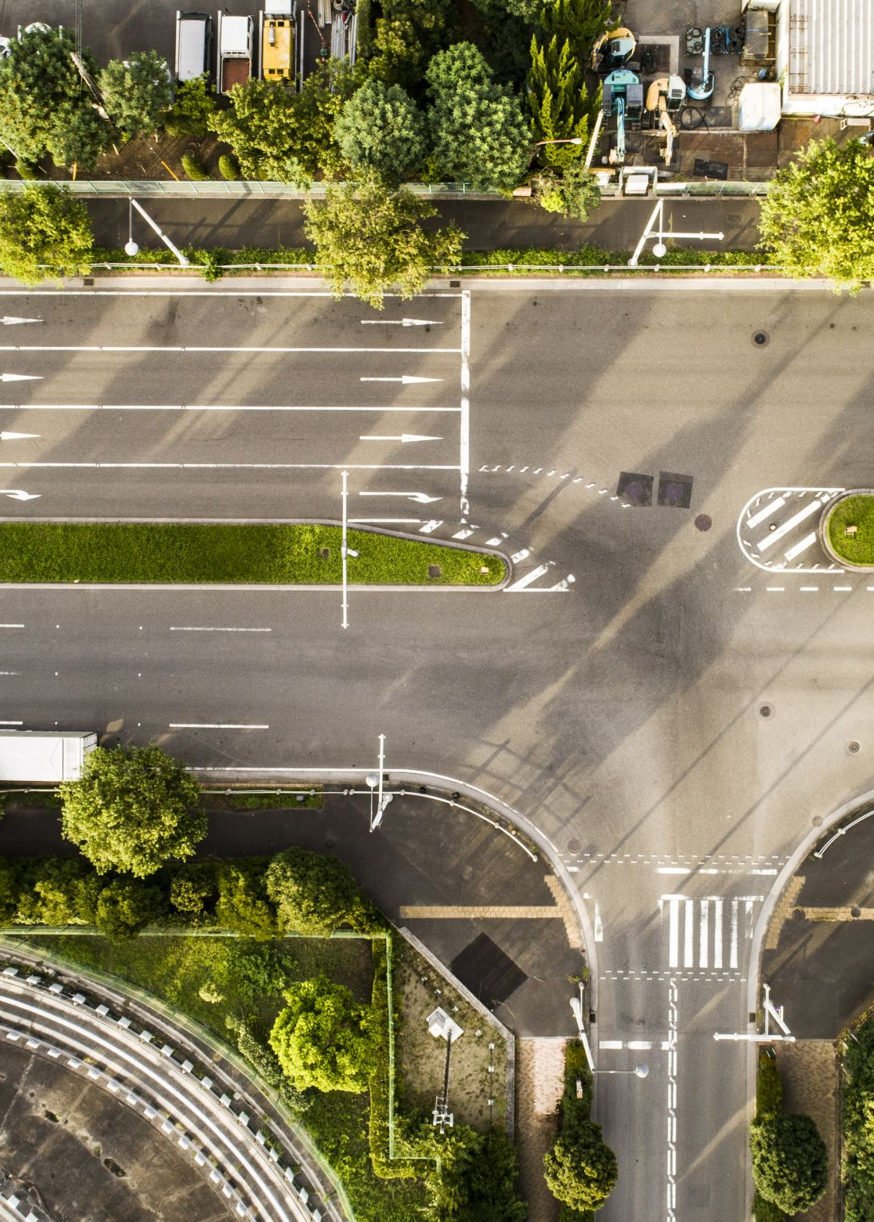
Conclusion
IoT-based smart parking systems enhance the overall parkingexperience, improve the utilization of parking resources, and contributeto more sustainable and efficient urban environments. These systemscontinue to evolve with advancements in IoT technology, dataanalytics, and user interfaces.

